Slide 1
Seminar
By Owain Mahoney, Jake Watkins-Brown,
Pawel Kaczmarczyk, Matthew Wisden

Slide 2
The payroll system
The purpose the payroll system is:
To calculate take-home salary before and after tax.
The calculator will be able to subtract the national insurance from the salary.
The payroll system will be able to use tax codes to make sure the employee will be paying the right amount of tax.
To make the system secure we will add a login system so that users on the whitelist can gain entry to the system.
The user will have to accept the terms and conditions before they can gain entry.

Slide 3
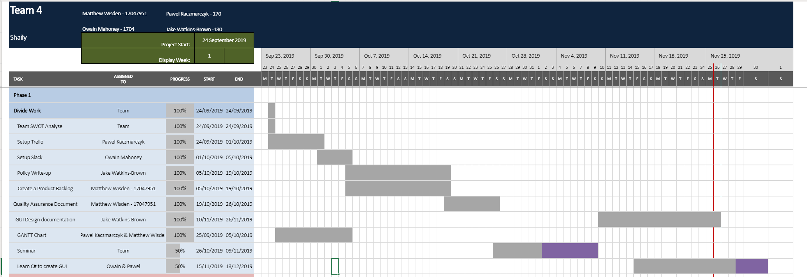
GANTT Chart
Used to make sure tasks were completed on-time.
Kept up-to-date.

Slide 4
How will we carry out quality assurance
Use the quality assurance document we created at the beginning of the project as a guide.
Every week we will check the quality assurance to see if we meet the standards that we have set ourselves.
If we fail to meet the standards that we have set in the quality assurance, we will go back and fix the issues.

Slide 5
LSEPI – Legal, Social, Ethical and Professional issues
LSEPI is basically the terms and conditions that the user must agree to before they can use the payroll system
This is used to confirm that the user understands how to use the program in an effective manner without misusing it and to understand that there will be repercussions for misuse.
In the LSEPI there will be mentions of the BCS, policy and regulation, responsibilities, ethics and privacy.
If the policy is broken, then the user is subject to removal of their current job and may be arrested.

Slide 6
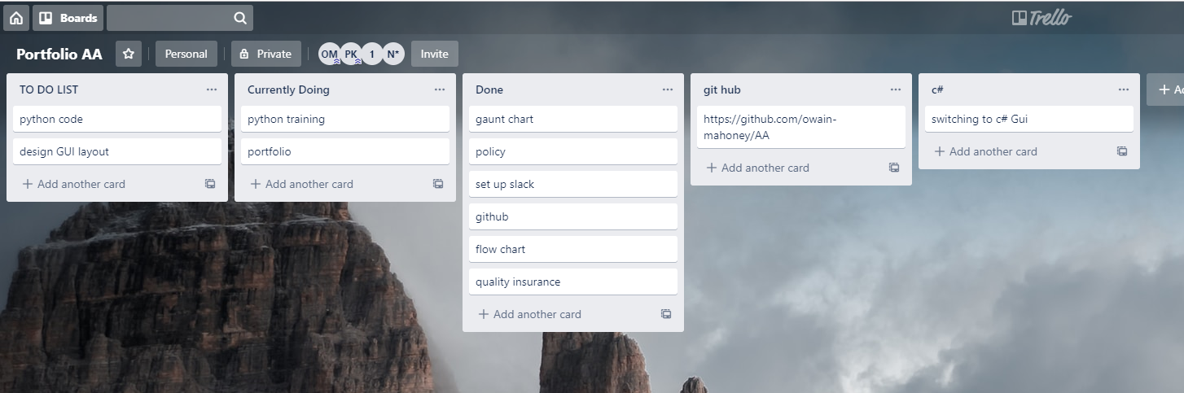
Trello (Old)

Slide 7
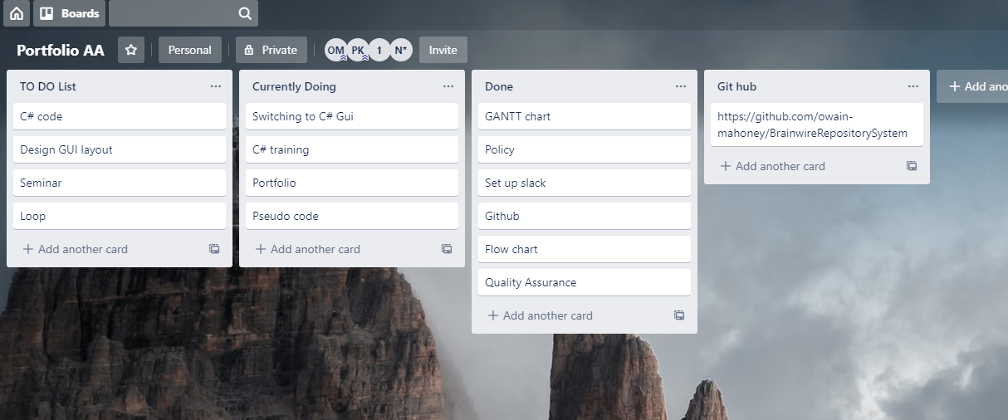
Trello (New)

Slide 8
Sources of communication
We used Slack and Messenger as our means of communication
It was useful and effective for group discussions when our group could not be there face to face
We used Messenger for group voice chats to discuss the project because Slack didn't support group voice chats, only singular voice chats.

Slide 9
SCRUM Master
Responsibilities of a SCRUM master:
Make sure that the Quality assurance is followed each week.
Make sure the GANTT chart is updated.
Set up meetings such as physical meetings and digital meetings.
Keeping the team as agile as possible.

Slide 10
Story Board
The following slides will show how the program generally functions and not so much about the design of the program

Slide 11
Start screen for login
Username
Text box
Password
Text box
Click me to accept terms and conditions click here
✔
Button press me

Slide 12
Pseudo code
WHEN Button is pressed
If check box is checked
SQL command = "Select username from EMP where username = txt_username"
SQL command = "Select password from EMP where password = txt_password"
If SQl comes back true for both enter form
Else message box not match
Else checked needs to be checked

Slide 13
If incorrect username/password
Incorrect username/password please try again
Username
Password
Ok

Slide 14
If disagree with LEPSI
Username
You must agree to Terms and conditions
Password
Ok

Slide 15
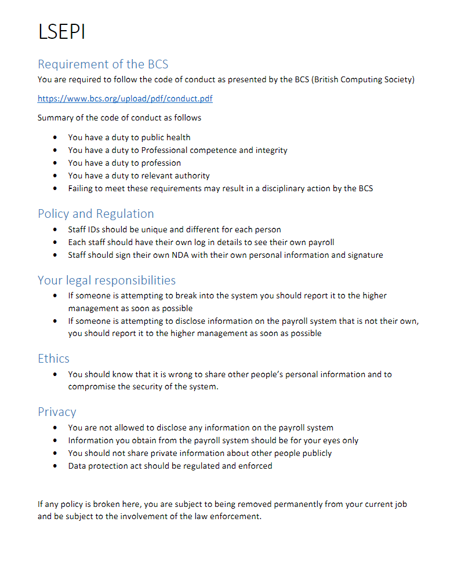
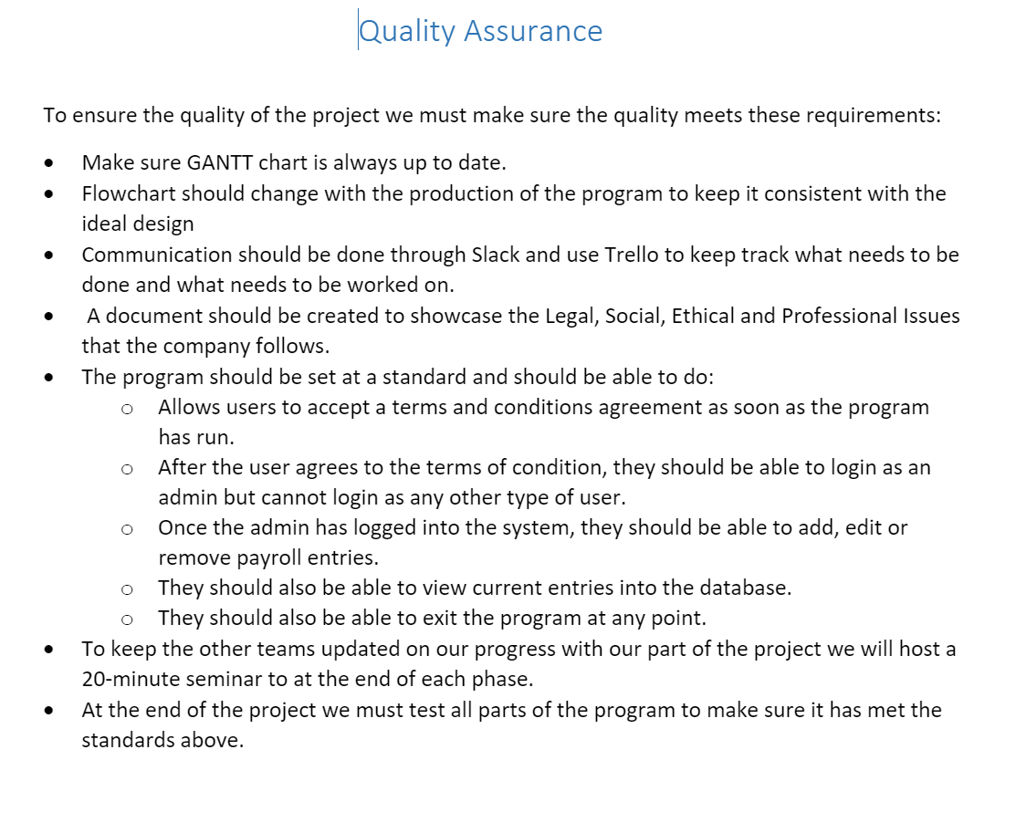
When the "clicked here" is pressed

Slide 16
If Home is pressed
Home
Your payroll
Your benefits
Calculator
Logout
Home screen

Slide 17
If Your payroll is pressed
Home
Your payroll
Your benefits
Calculator
Logout
Your payroll details

Slide 18
If Your benefits is pressed
Home
Your payroll
Your benefits
Calculator
Logout
Your benefits details

Slide 19
If calculator is selected
Home
Your payroll
Your benefits
Calculator
Logout
Calculator

Slide 20
More Pseudo code
Pass text inputs into function
double Tax cal (int sal, double tax)
Return sal * tax
Display Tax cal in text box

Slide 21
If log out is pressed
Username
Text box
Password
Text box
Click me to accept terms and conditions click here
✔
Button press me

Slide 22
What issues did we encounter?
Administration issues with GitHub and Trello
Lack of experience in using new applications like Slack and Trello
Slack didn't have group voice chats, so we had to use another application (Messenger) to be able to communicate
Python wasn't working the way we had hoped it would work. We made a group decision on using C# instead (More on that next slide)
No design requirements. The instructions are unclear and vaguely written.

Slide 23
Why did we choose C# over python
We chose C# over Python because we had more opportunities to design the payroll system.
Python was a relatively new programming language that we had little to no experience working with, whereas with C# we knew more.

Slide 24
